Slide 1
Machine and Deep Learning Project
Team Members: Mohamed Mohamed
Mario shady
Mohamed Mourad
Christine Shraf
Supervised by: Dr. Ammar Mohamed

Slide 2
Machine and Deep Learning Project
START
Introduction
Dataset

Slide 3
Machine and Deep Learning Project
START
Introduction

Slide 4
Machine and Deep Learning Project
START
Introduction
Our project is classifying and predicting lego blocks. We have 16-block types "16 classes" with multiple features. Our final aim is to be able to give our model any lego photo, and that the model will be able to identify which type of block this vague block is we will reach this goal through getting a dataset, cleaning the dataset, resizing all images, normalizing them, etc. Then, we will use multiple classifiers "Convolutional Neural Network, K-Nearest-Neighbor, Support Vector Machine, Naive Bayes" in order to reach the highest accuracy of predicting and classifying unknown lego-blocks into its right block type

Slide 5
Machine and Deep Learning Project
START
Introduction

Slide 6
Machine and Deep Learning Project
START
Introduction
Dataset

Slide 7
Machine and Deep Learning Project
START
Dataset

Slide 8
Machine and Deep Learning Project
START
Dataset
Approximately 12,700 images of 16 different Lego bricks classified by folders and computer rendered using Blender

Slide 9
Machine and Deep Learning Project
START
Dataset

Slide 10
Machine and Deep Learning Project
START
Introduction
Dataset

Slide 11


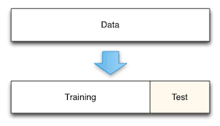




K-Nearest Neighbour
Naïve Bayes
Train and Test
Support Vector Machine
Logistic Regression
Test and Score
Neural Science
Thank you

Slide 12
K-Nearest Neighbour
The k-nearest neighbors (KNN) algorithm is a simple, supervised machine learning algorithm that can be used to solve both classification and regression problems. It's easy to implement and understand but has a major drawback of becoming significantly slows as the size of that data grows.

Slide 13
K-Nearest Neighbour
Naïve Bayes
Train and Test
Support Vector Machine
Logistic Regression
Test and Score
Neural Science
Thank you

Slide 14
Naïve Bayes
Naïve Bayes Classifier is one of the simple and most effective Classification algorithms which helps in building the fast machine learning models that can make quick predictions. It is a probabilistic classifier, which means it predicts on the basis of the probability of an object.

Slide 15
K-Nearest Neighbour
Naïve Bayes
Train and Test
Support Vector Machine
Logistic Regression
Test and Score
Neural Science
Thank you

Slide 16
Support Vector Machine
SVM is one of the most popular Supervised Learning algorithms, which is used for Classification as well as Regression problems. However, primarily, it is used for Classification problems in Machine Learning.

Slide 17
K-Nearest Neighbour
Naïve Bayes
Train and Test
Support Vector Machine
Logistic Regression
Test and Score
Neural Science
Thank you

Slide 18
Logistic Regression
Logistic regression is a supervised learning classification algorithm used to predict the probability of a target variable. The nature of the target or dependent variable means there would be only two possible classes.

Slide 19
K-Nearest Neighbour
Naïve Bayes
Train and Test
Support Vector Machine
Logistic Regression
Test and Score
Neural Science
Thank you

Slide 20
Neural Science
A neural network consists of units (neurons), arranged in layers, which convert an input vector into some output. Each unit takes an input, applies an (often nonlinear) function to it, and then passes the output on to the next layer. Generally, the networks are defined to be feed-forward: a unit feeds its output to all the units on the next layer, but there is no feedback to the previous layer.

Slide 21
K-Nearest Neighbour
Naïve Bayes
Train and Test
Support Vector Machine
Logistic Regression
Test and Score
Neural Science
Thank you

Slide 22
K-Nearest Neighbour
Naïve Bayes
Train and Test
Support Vector Machine
Logistic Regression
Test and Score
Neural Science
Thank you

Slide 23
Test and Score
To calculate the Accuracy, we used five algorithms, four of which are machine learning classification methods and one deep learning algorithm. The accuracy is between 71 percent and 99 percent.

Slide 24
K-Nearest Neighbour
Naïve Bayes
Train and Test
Support Vector Machine
Logistic Regression
Test and Score
Neural Science
Thank you

Slide 25
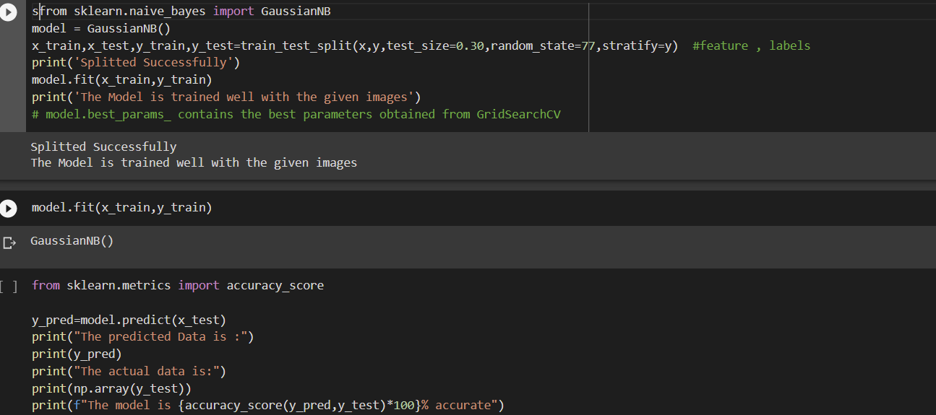
Train and Test

Slide 26
K-Nearest Neighbour
Naïve Bayes
Train and Test
Support Vector Machine
Logistic Regression
Test and Score
Neural Science
Thank you

Slide 27


